Slide 1
Tramroads in East Shropshire
A talk by Revd Roger Farnworth
The Friends of Ironbridge Gorge Museum Trust
7.30pm 18th October 2023.

Slide 2

Tramroads in East Shropshire
Notes for this talk can be found on the following
link on my blog (rogerfarnworth.com):
https://rogerfarnworth.com/2023/01/22/ancient-tramroads-near-telford-part-10-an-overview-of-the-east-shropshire-areas-tramroad-network/

Slide 3
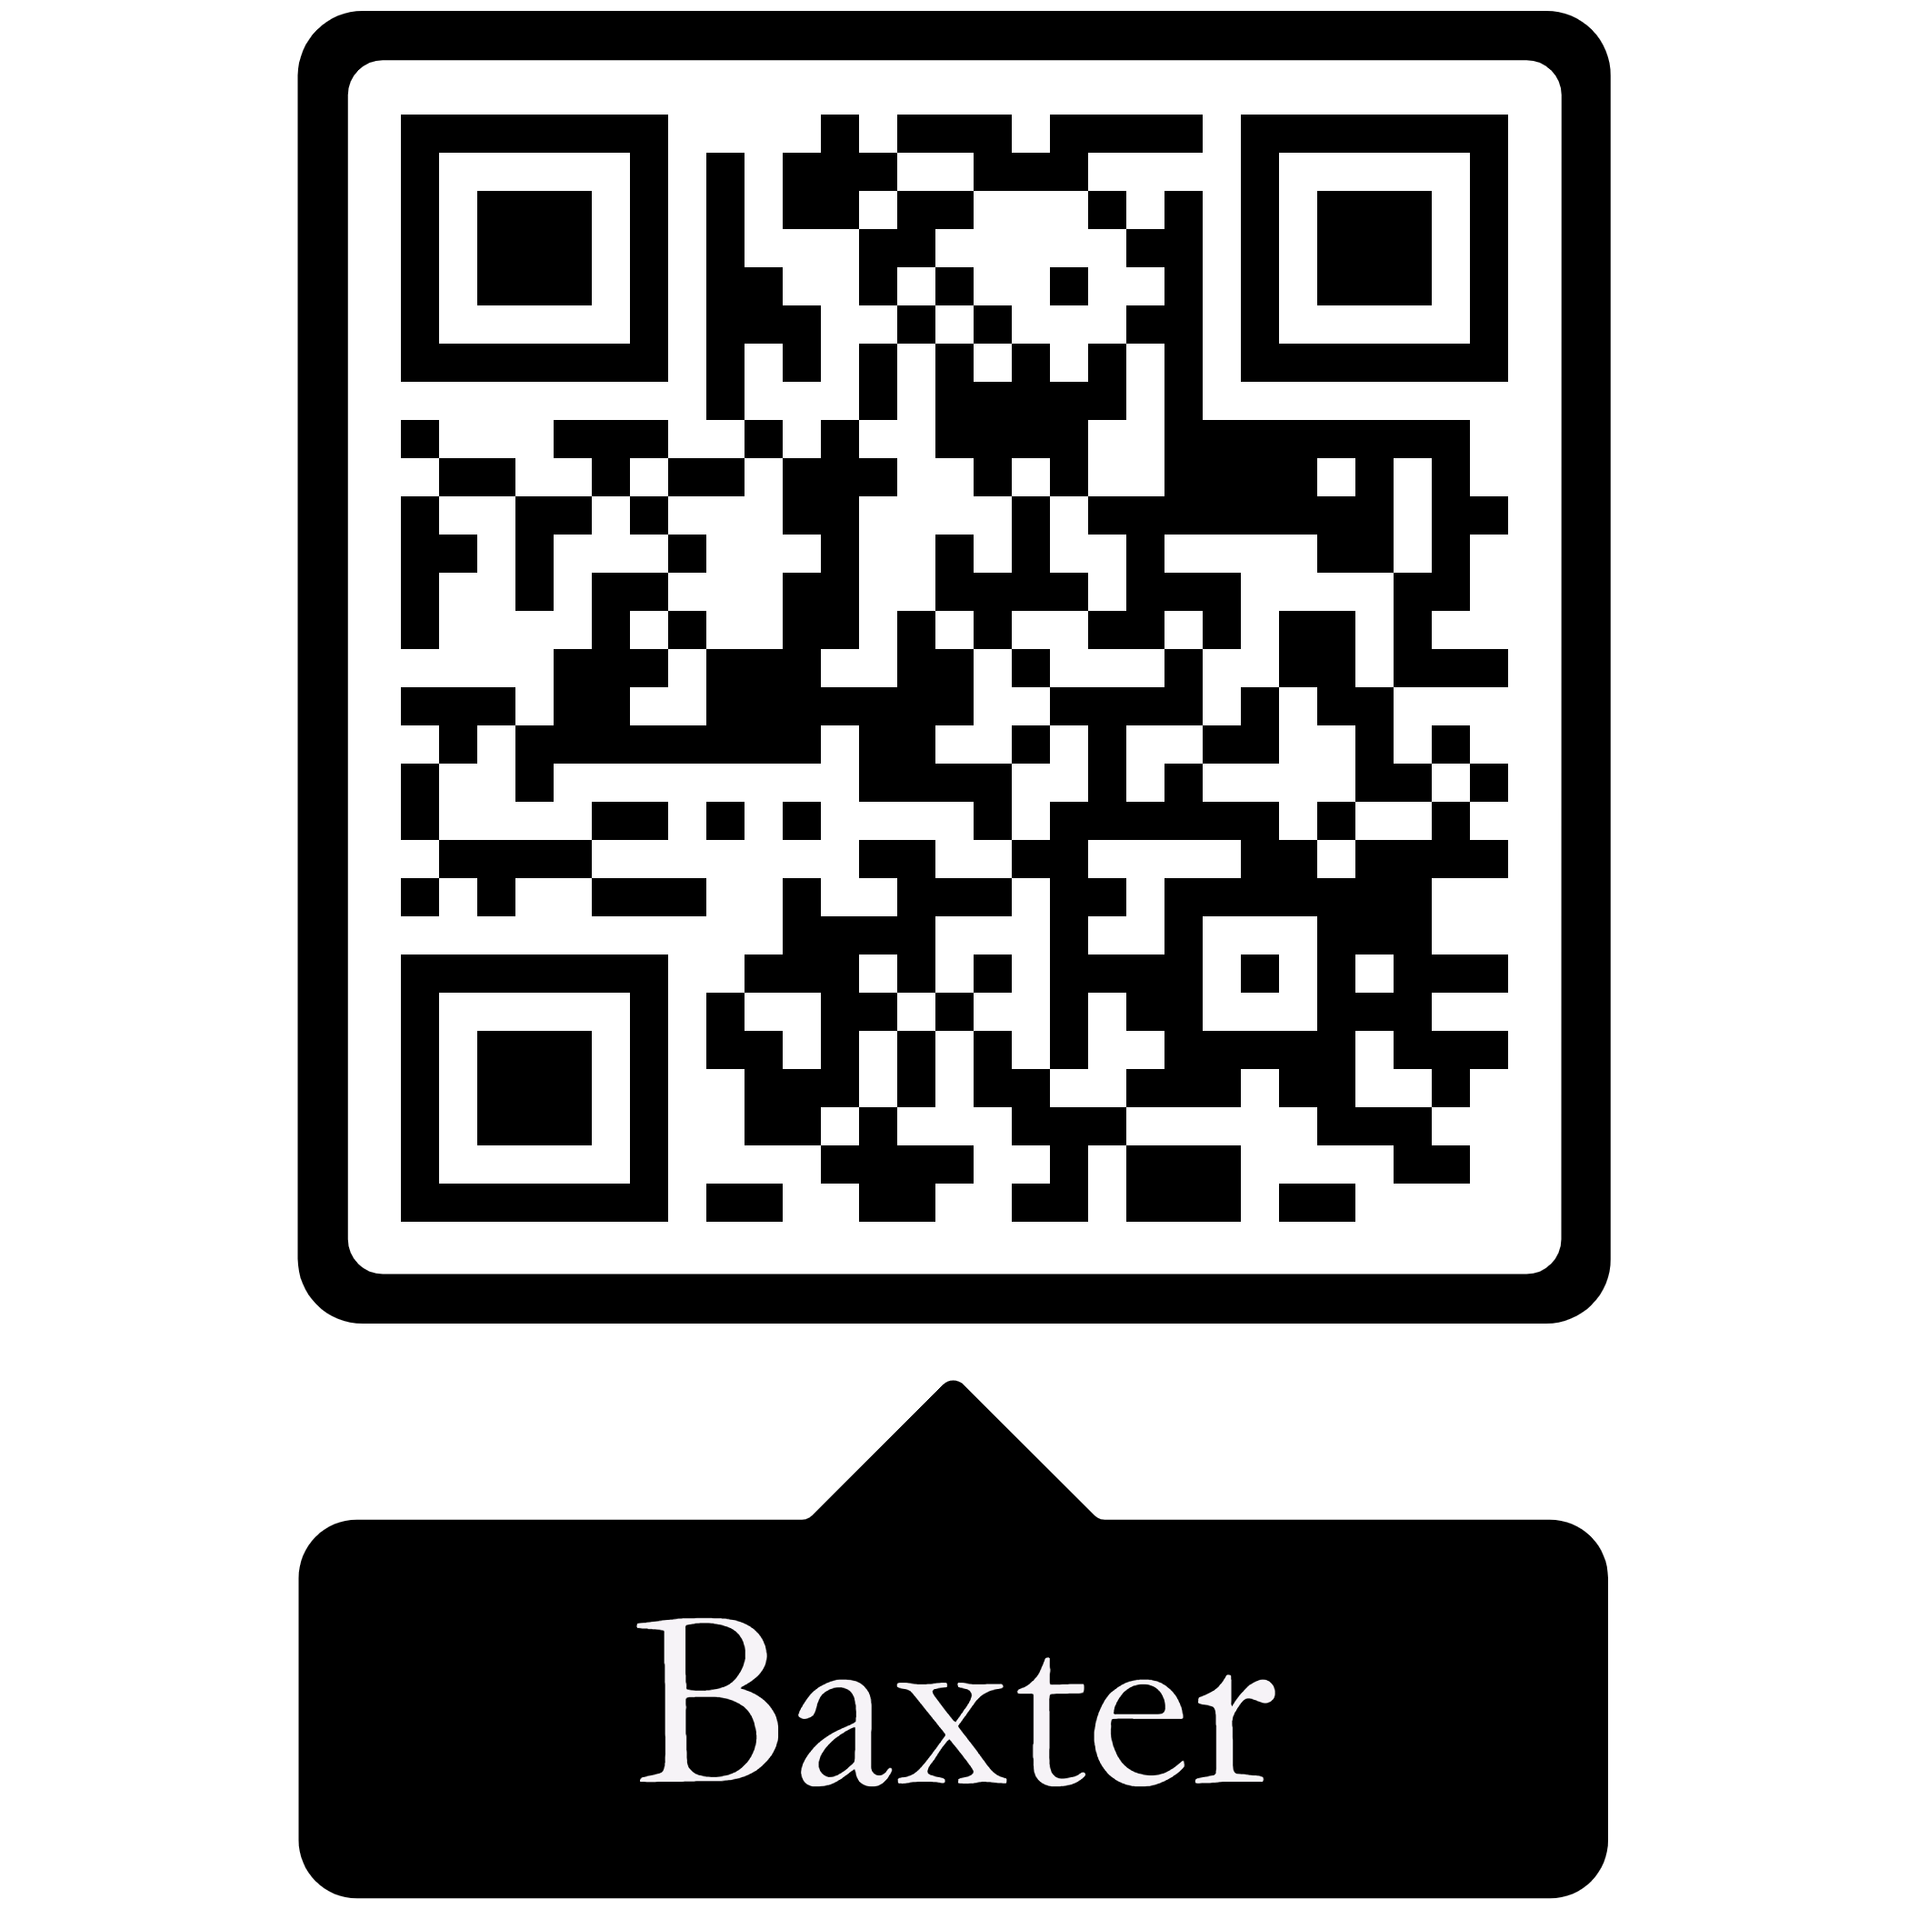



Tramroads in East Shropshire
Resources:
Bertram Baxter; Stone Blocks and Iron Rails ; David & Charles, Newton Abbott, 1966.
Mark Jones; Discovering Britain’s First Railways ; The History Press, Cheltenham, 2012.
Derek Hayes; The First Railways ; The Times, HarperCollins, Glasgow, 2017.
Heather Hurley; Horse Drawn Tramways of the Wye Valley ; Logaston Press, Eardisley, 2022.
R.F. Savage & & L.D.W. Smith; The Waggon-ways and Plate-ways of East Shropshire ; Birmingham School of Architecture, 1965. (Ironbridge Museum Trust Archive)
The International Conferences on Early Railways

Slide 4
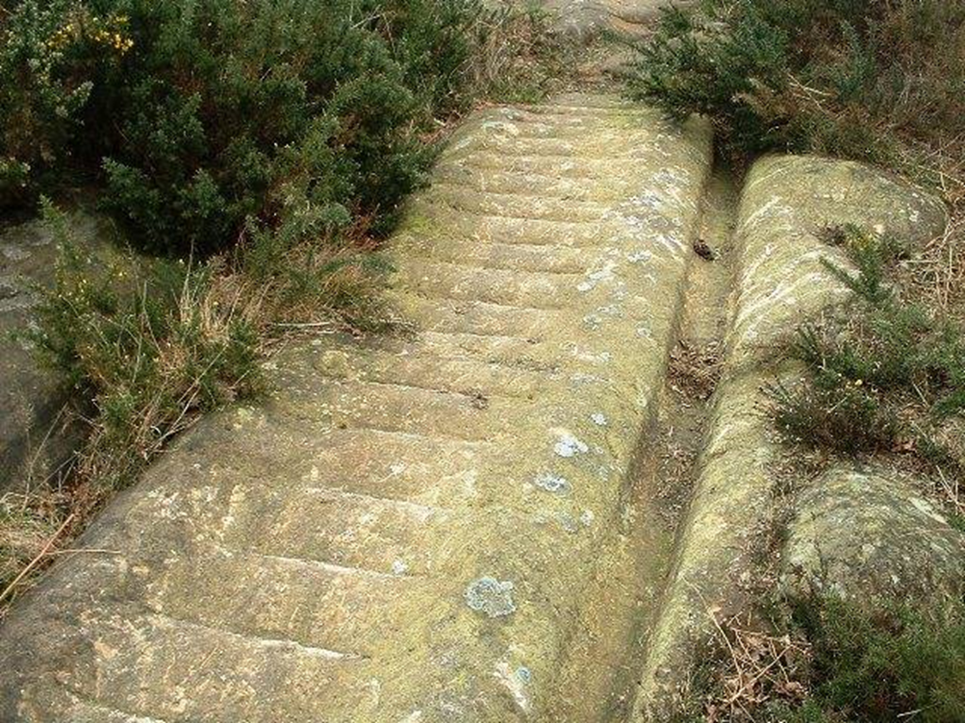
Early History – Railways/Tramroads (1)
Rutways
A Rutway on Isthmus of Corinth was in use between 650 BC and 1st century AD but after appears to have been forgotten.
[https://www.timetoast.com/timelines/railroads-a167585d-a6ef-4bea-9b81-a141344ce16d, accessed on 9th January 2023.]

Slide 5
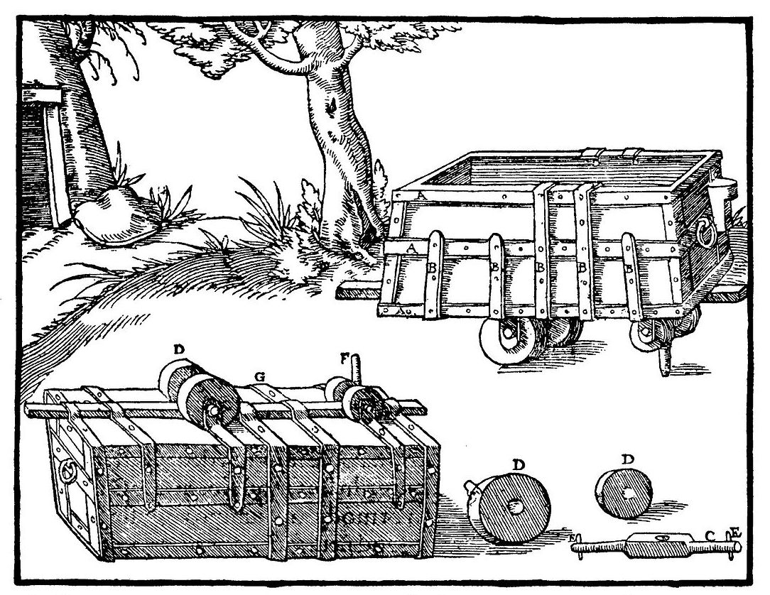
Early History – Railways/Tramroads (2)
Early German Hunds used a pin running between two parallel planks of wood.
The very earliest, primitive ‘railways’ in this area were some of the earliest in the UK, but not the earliest.
Some Cornish ‘rutways’ might date back to the 1550s
The first ‘railways’ elsewhere in England probably date, at the earliest, from the second half of the 16th century and were associated with mines where German-speaking miners were employed.

Slide 6
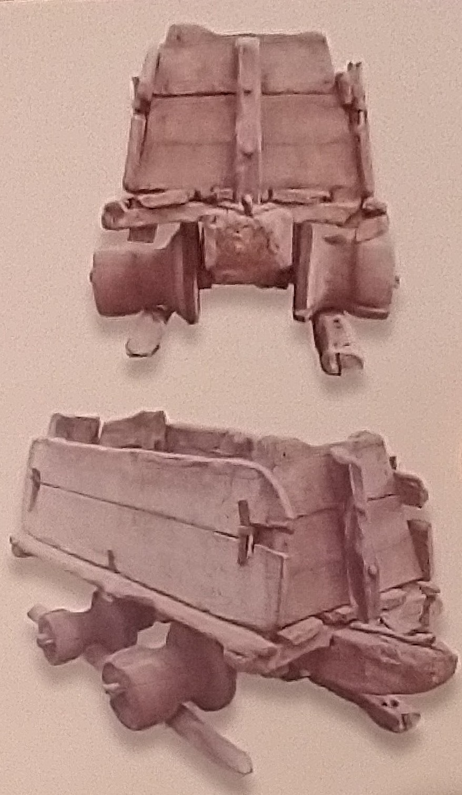
Early History – Railways & Tramroads (2)
Wooden Waggonways
Underground man-powered railways in metal mines are very old and can be established beyond reasonable doubt as being in use by 1569 in Cumbria.
[Warren Allison et al; An early railway in the German mines of Caldbeck; Early Railways 4.]
A mining truck, (a risen) with flanged roller wheels from a gold mine in Hungary on display in the Deutches Tecnikmuseum in Berlin. [Derek Hayes: p14]

Slide 7
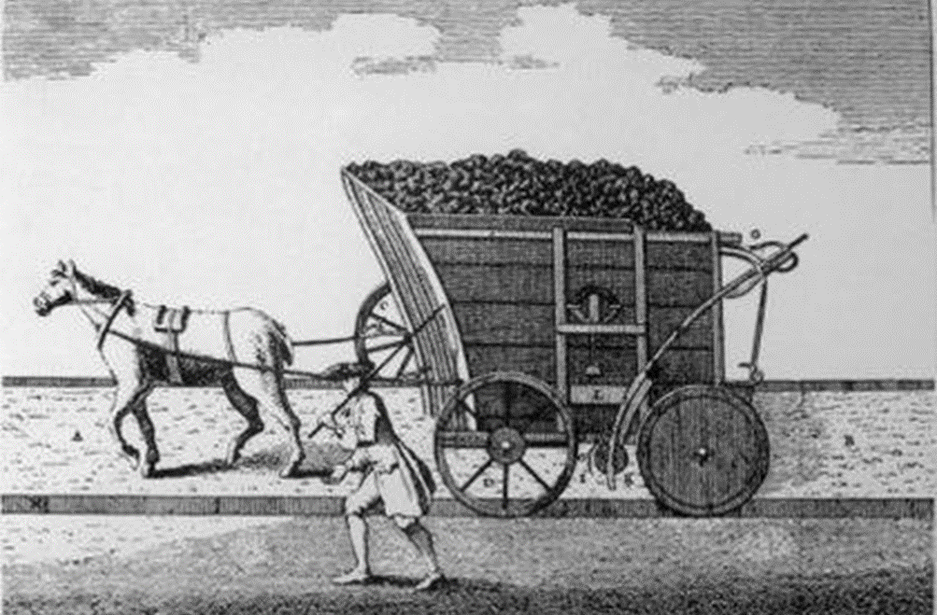
Early History – The Cradle of the Industrial Revolution
Geology – limestone, charcoal, coal and iron ore available locally.
Topography - mining at a relatively small scale was easier than elsewhere.
Proximity – transport costs lower than elsewhere

Slide 8
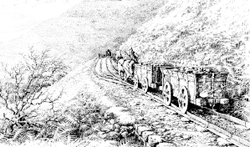
Early History – Railways/Tramroads (3)
One of a series of sketches of tramroad locations drawn by Michael Blackmore. It shows larger, later, waggons on a plateway.
James Clifford, Broseley may have been using a tramroad as early as 1575 to deliver coal to his wharf on the River Severn.
William Brooke was working his coal mines in Madeley. He may have been using a tramroad at about the same time.
By the early 1600s, wooden railways, ‘waggonways’, were being laid as overland systems, connecting a drift or a shaft-head with navigable water, or occasionally with an interchange yard on a road system.

Slide 9
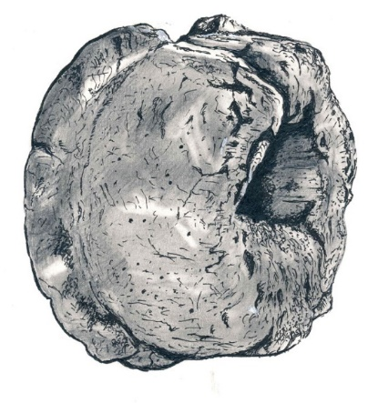
Early History – Railways/Tramroads (4)
Early rails were wooden, fastened down, end to end, on logs of wood or ‘sleepers’, placed crosswise at intervals of two or three feet. A layer of wood could be used to protect the more substantial timber rails. As iron became more freely available, it became more common to cover the rails with a thin, flat iron strip, adding longevity and reducing friction. This ‘wearing’ rail, could be easily renewed when worn. It was then possible to cover the sleepers with earth to protect them from the horses’ feet. The wearing rail caused more wear on the wooden wagon wheels, so iron wheels were introduced in the 18th Century. The routes of these wagonways, laid by permission ("way-leaves.") of local landowners, led to a canal, river or boat dock for onward shipment.
A sketch of a wooden tram wheel held by the Ironbridge Gorge Museum Trust

Slide 10
Early History – Railways/Tramroads (5)
Across the UK, different traditions arose out of diverse needs. In many areas of the UK, mining required the sinking of a shaft to access the mineral bearing strata.
The Shropshire coalfield “developed smaller capacity systems running on narrower gauges. Here, mines were mainly levels, rather than deep mines such as prevailed in the north-east, and so a compact waggonway could run from the coalface to daylight and then down to navigable water. The Severn Ironbridge Gorge and its immediate environs were home to many such railways. From the mid-18th century, similar waggonways also ran direct from ironstone mines to Bedlam furnaces downstream of the later Iron Bridge.”
[David Gwyn and Neil Cossons; Early Railways in England: Review and summary of recent research; in Historic England, Discovery, Innovation and Science in the Historic Environment Research Report Series No. 25-2017: p23]

Slide 11
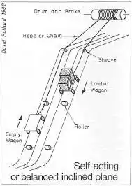
Early History – Railways/Tramroads (6)
The steep sides of Ironbridge Gorge meant that inclined planes were necessary to get wagons to river wharves. These were developed early in the 1700s, elsewhere they were not used until the end of the 1700s
Self-acting or balanced inclined planes were used to move heavy loads on rails down the steep sides of Ironbridge Gorge.
Descending loads provided the necessary lift to return empty wagons to the top of the incline.
This sketch was included in a paper about Bath Stone Quarry Railways, (David Pollard; Bath Stone Quarry railways 1795/1830; British Industrial Archaeology Society Journal No. 15, 1982)

Slide 12
Early History – Railways/Tramroads (7)
“The descent to the river down the side of the Severn Gorge was precipitous, and the descent was controlled using a self-acting inclined plane, something not used near Newcastle until the late eighteenth century, but probably in Shropshire for its first railway.”
“Wilcox’s & Wells’ railway to Calcutts may have been down Birch Batch. Its terminus was later called Jackfield Rails, and it remained in use well into the nineteenth century.”
[Peter King; Before the Main Line; in ed. David St. John Thomas; How Railways Changed Britain; Railway & Canal Historical Society, Derby, 2015, p13 – 32: p25]

Slide 13
Early History – Railways/Tramroads (8)
A “longer railway, ultimately from John Wilkinson’s New Willey Furnace of 1757, went down Tarbatch Dingle to Willey Wharf but was probably built in the 1700s to serve coalmines and remained in use in parts for some 300 years, though from 1862 it led to the Severn Valley Railway, rather than a river wharf .”
[Peter King; Before the Main Line; in ed. David St. John Thomas; How Railways Changed Britain; Railway & Canal Historical Society, Derby, 2015, p13 – 32: p25]

Slide 14
Early History – Railways/Tramroads (9)
The “establishment of new coke-fired furnaces in the 1750s and the expansion of mining led to the provision of further railways, the longest running from Ketley (near Watling Street) to Coalbrookdale Wharf on the Severn, so that by about 1775, Abiah Darby (the widow of Abraham II) stated that the Company had 20 miles of railways.”
[David Gwyn and Neil Cossons; Early Railways in England: Review and summary of recent research; in Historic England, Discovery, Innovation and Science in the Historic Environment Research Report Series No. 25-2017: p23]

Slide 15
Early History – Railways/Tramroads (10)
“By the mid-17th Century tramroads were fairly common and continued to be so through the 18th century, so that by the start of the 19th Century they often ran for considerable distances, taking mineral products (notably coal) from their source to the point of consumption, or … to a canal wharf for onward carriage by boat.”
https://www.sinfin.net/railways/railhist.html, accessed on 17th April 2022.

Slide 16
Early History – Railways/Tramroads (11)
These early wooden tramways included:
Benthall Railway
Caughley Railway
Gleedon Hill Tramroad
Sutton Wharf Tramroad
Tarbach Dingle Tramroad
The Coalbrookdale Company
Tramroads
Deerleap Tramway
Lime Kilns Tramway
Ash Coppice Tramway
Clay Mine Tramway
Jackfield Railway
Corbetts Dingle
NB: no one source has this full list, which even so, may not be comprehensive.

Slide 17
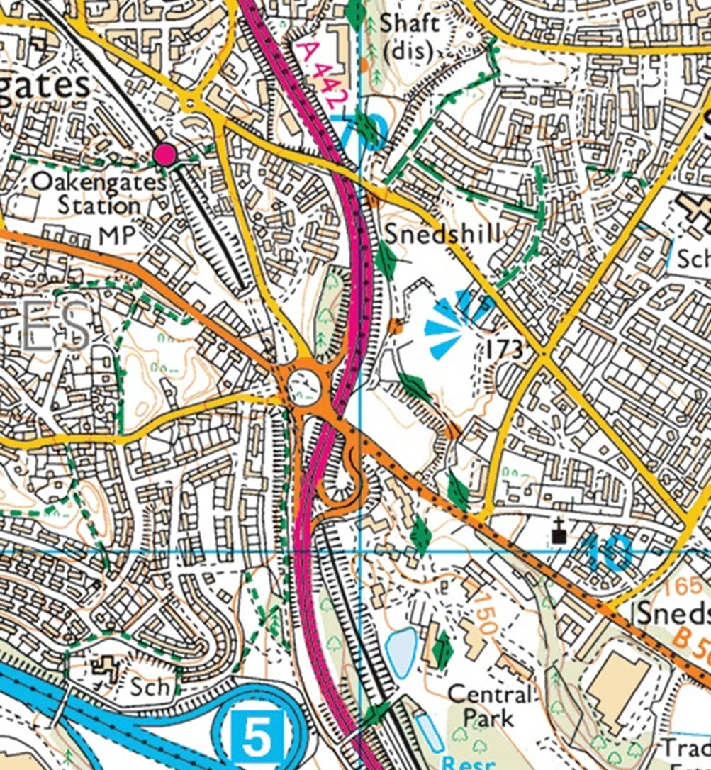
The Use of Maps (1)
A Local Example:
Oakengates
Source: National Library of Scotland
(a free on-line resource)
Modern mapping provides some clues as to what was present in the past but, in the Telford area, care is needed in interpreting those signs.

Slide 18
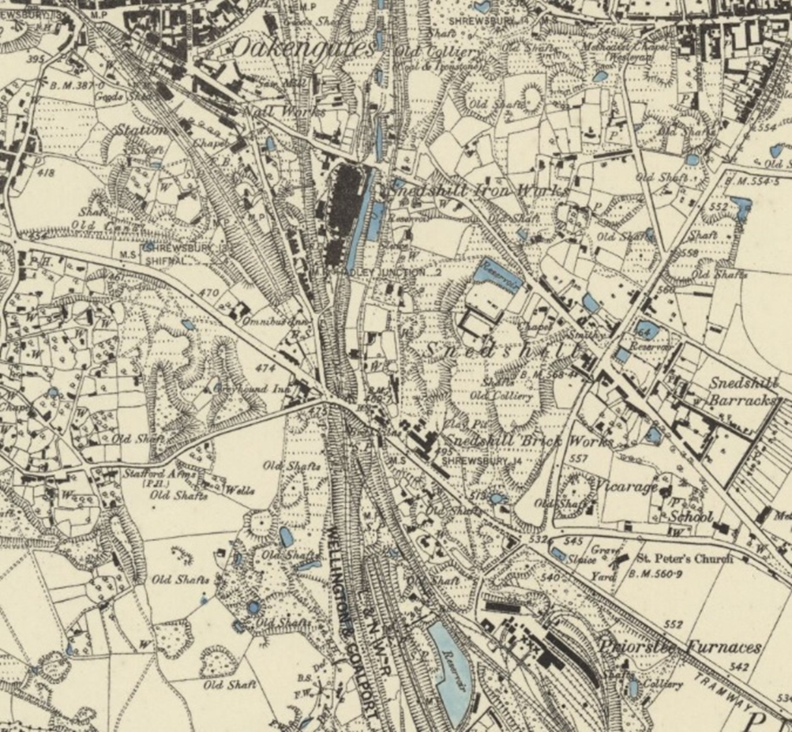
The Use of Maps (2)
A Local Example:
Oakengates
The same area, but on the Ordnance Survey 6” Mapping surveyed 1880-1882 and published in 1885.
[https://maps.nls.uk/view/101594308, accessed on 9th January 2023.]

Slide 19
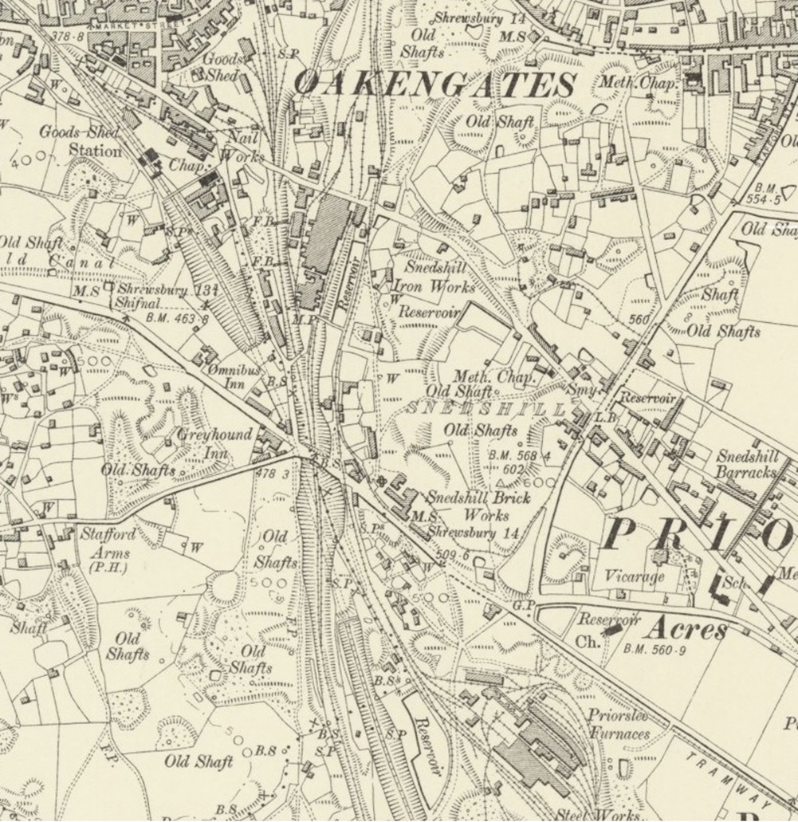
The Use of Maps (3)
A Local Example: Oakengates
The same area, but on the Ordnance Survey 6” Mapping revised in 1901 and published in 1902.
[https://maps.nls.uk/geo/explore/#zoom=15.0&lat=52.68905&lon=-2.43995&layers=6&b=1, accessed on 9th January 2023]
Most information on these maps can be relied on but, in relation to railways, care needs to be taken over relying on the detailed arrangement of points and sidings shown.

Slide 20
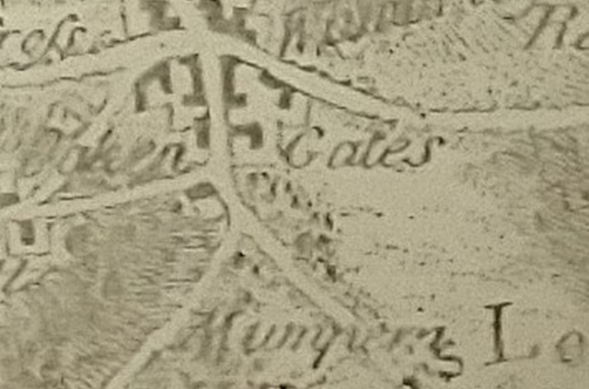
The Use of Maps (4)
Earlier Mapping
J. Rocque’s Map of 1752.
This enlarged extract shows very little detail other than roads and settlements.
[J. Rocque; Map of the County of Salop (NE), 1752: Shropshire Archives.]

Slide 21
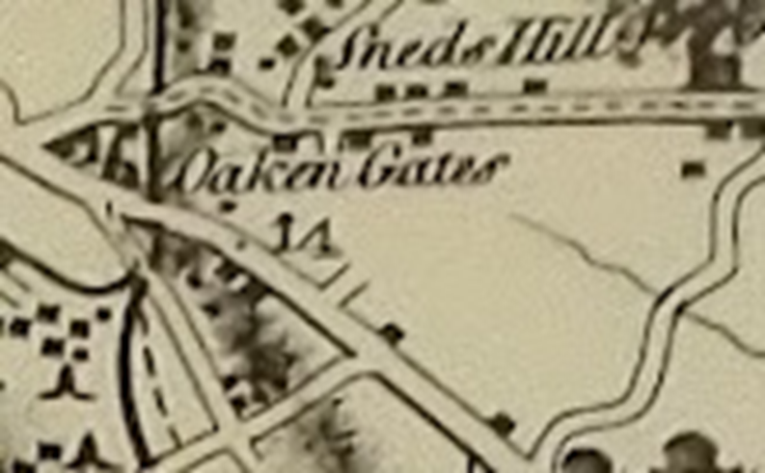
The Use of Maps (5)
Earlier Mapping
R. Baugh’s map of Salop, 1808.
This enlarged extract shows canals and roads but otherwise detail is sparse.
[R. Baugh; Map of the County of Salop (No. 5), 1808, Shropshire Archives.]

Slide 22
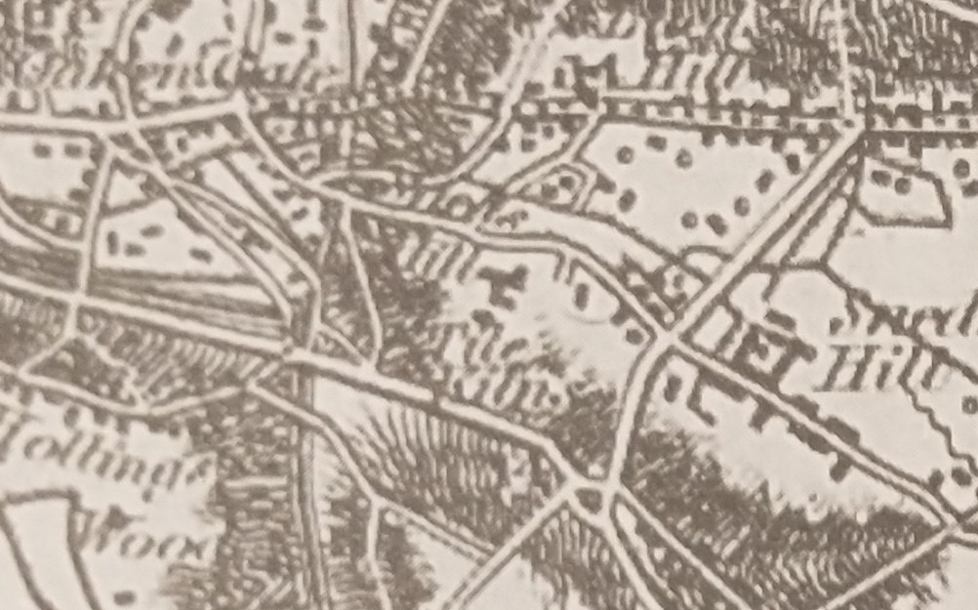
The Use of Maps (6)
Earlier Mapping
Greenwood’s map of the County of Salop, 1827.
A significant improvement, with roads, canals and railroads shown.
[Christopher Greenwood; Map of the County of Salop Facsimile Edition; Shropshire Archaeological and Historical Society, 2008.]

Slide 23
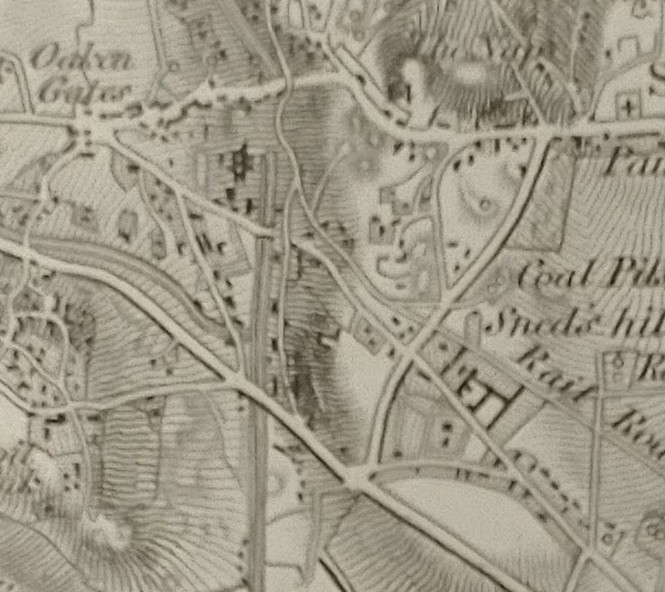
The Use of Maps (6)
Earlier Mapping
Ordnance Survey 1st Edition (1” to 1 mile) 1833.
A further significant improvement, with roads, canals and railroads shown more clearly.
[Ordnance Survey; Map 61(NE), 1833, Shropshire Archives.]

Slide 24
Savage & Smith in the 1960s (1)
The Waggon-ways and Plate-ways of East Shropshire.
Savage & Smith undertook research in the mid-1960s which catalogued many of the tramroads/tramways which once existed in the area of Ironbridge Gorge and to its North & South.
It was very timely research as within just a few years the Development Corporation would be remoulding much of the local landscape, and it was undertaken without the benefit of modern mapping.
[R.F. Savage & L.D.W. Smith; The Waggon-ways and Plate-ways of East Shropshire, Birmingham School of Architecture, 1965. An original document is held by the Archive Office of the Ironbridge Gorge Museum Trust.]

Slide 25
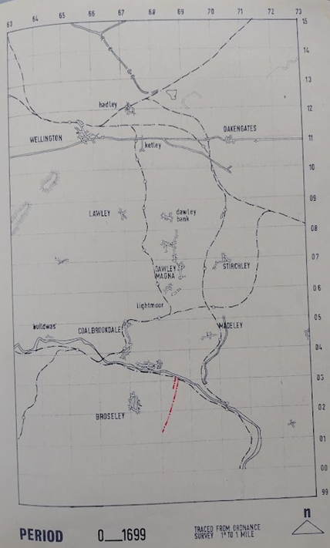
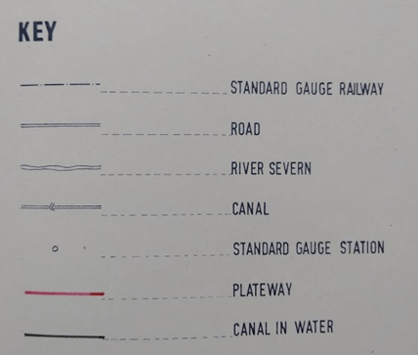
Savage & Smith in the 1960s (2) – Period to 1699
Wooden Rails – 1” to 1 mile

Slide 26
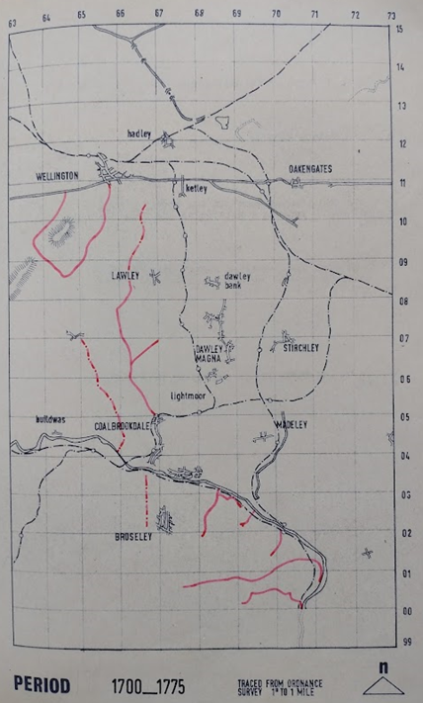
Savage & Smith in the 1960s (3) – 1700 – 1775
Wooden Rails – 1” to 1 mile

Slide 27
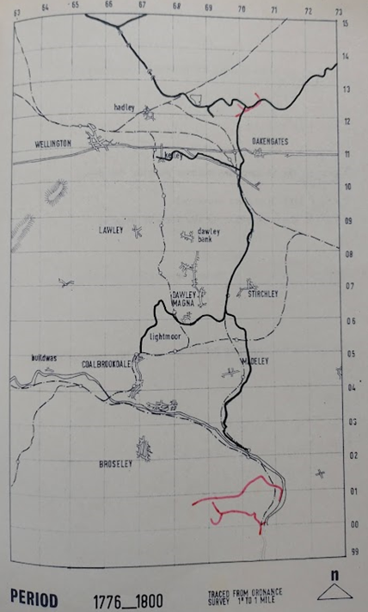
Savage & Smith in the 1960s (4) – 1776 – 1800 Wooden Rails – 1” to 1 mile

Slide 28
Cast Iron Rails (1)
“1767 saw the introduction of the first cast iron rails. … Cast Iron was thought to have been developed in 1767 by the Coalbrookdale Company in 1767 but it has also been suggested that such rails were being made at Hunslett Carr in Leeds for the Middleton Railway prior to its opening in 1758.”
[Mark Jones; Discovering Britain’s First Railways; The History Press, Cheltenham, 2012]
It is possible that the cast iron rails at both locations were initially cover plates for wooden rails, rather than entirely cast iron rails

Slide 29
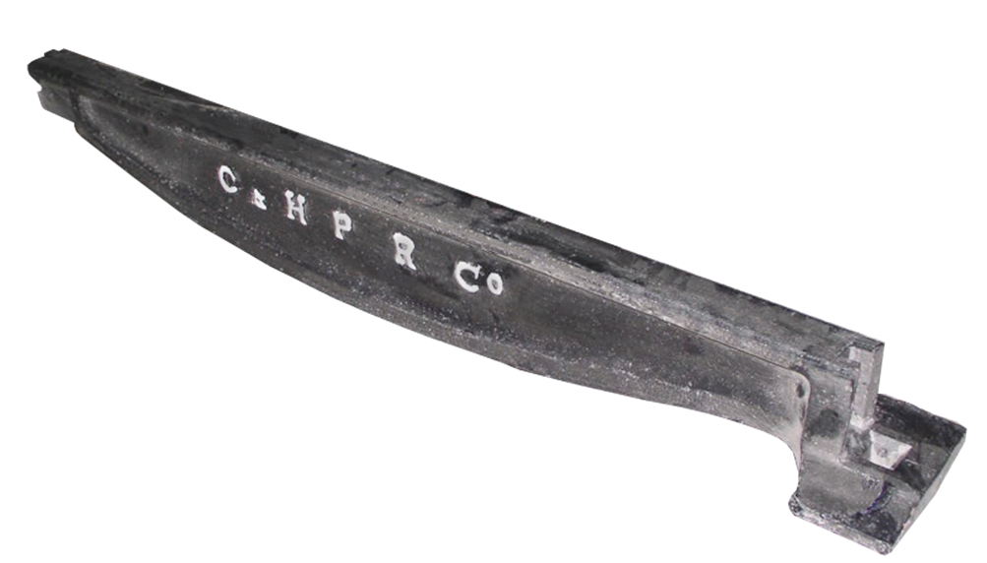
Cast Iron Rails (2)
Two forms of Cast Iron Rail were developed in different parts of the UK:
Edge Rails: Often 'fish-bellied' as shown here, Iron Edge-Rails projected above the track-bed to engage with the flanged wheels of the waggon.
Cast iron fish-belly edge rail manufactured in 1831 by Benjamin Outram at the Butterley Company Ironworks (formed in 1790) for the Cromford and High Peak Railway).

Slide 30
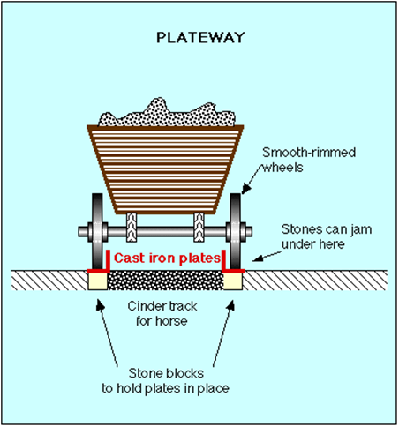
Cast Iron Rails (3)
Two forms of Cast Iron Rail were developed in different parts of the UK.:
Plate Rails: L-shaped rails which sat on stone blocks. Often, these tramroads were referred to as Plateways. The cinder track for the horse could be as shown here, or it could be at the height of the top of the rails. … Plateways were the predominant form used, at first, in East Shropshire.

Slide 31
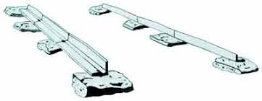
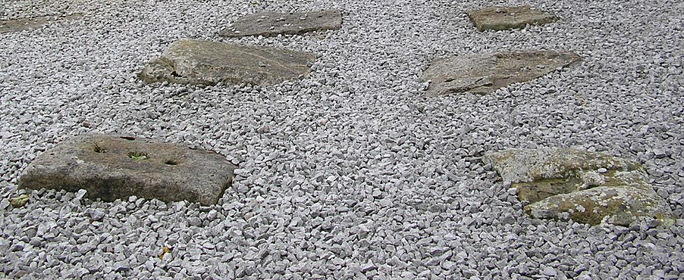
Cast Iron Rails (4)
Stone Blocks: L-shaped rails were sat on stone blocks. These stone blocks can often be found when walking old tramroad routes.
Sketch of the typical arrangement of rails and stone blocks.
Preserved Stone Blocks on the Peak Forest Tramway at Bugswoth Basin in Derbyshire

Slide 32
Cast Iron Rails (5)
It is important to note that, in Ironbridge Gorge and on the Coalbrookdale tramways at least, cast iron sleepers were used. They were observed by German visitors to the area in 1826/27:
“As is the case with all tramroads in this district, … the rails are 5 and even 5 ft 6 ins long and lie in cast-iron sleepers.”
C. von Oeynhausen and H. von Dechen; Railways in England 1826 and 1827; translated by E.A. Forward, ed. Charles E. Lee, Newcomen Society, 1971: p67.

Slide 33
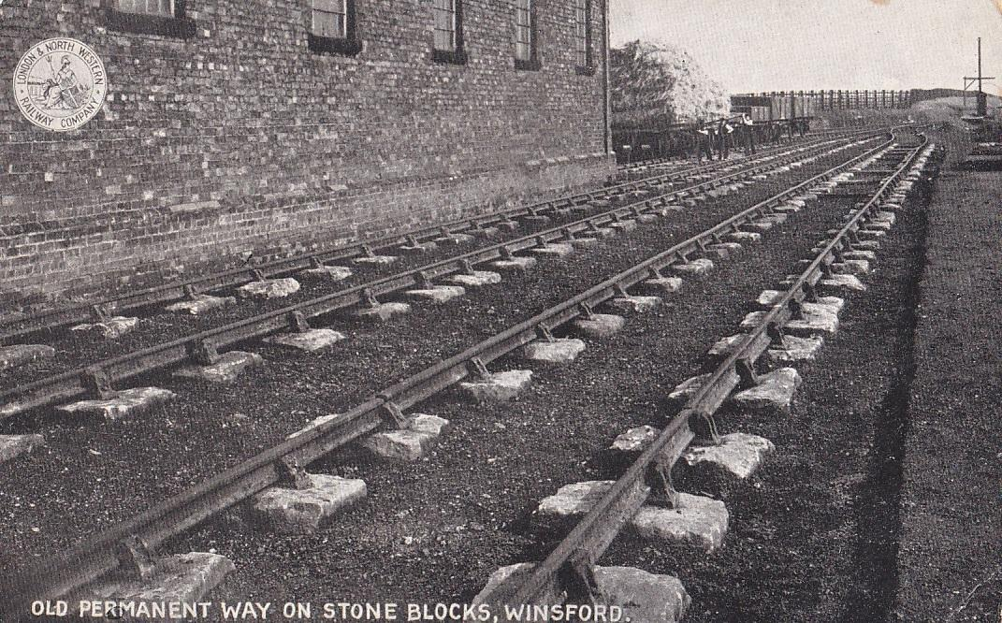
Cast Iron Rails (6)
L-shaped cast iron rails were gradually superseded by ‘edge rails’, once wrought iron with its higher tensile strength became available.
Edge Rails on old permanent way at Winsford in Cheshire. (Northwich Guardian)

Slide 34
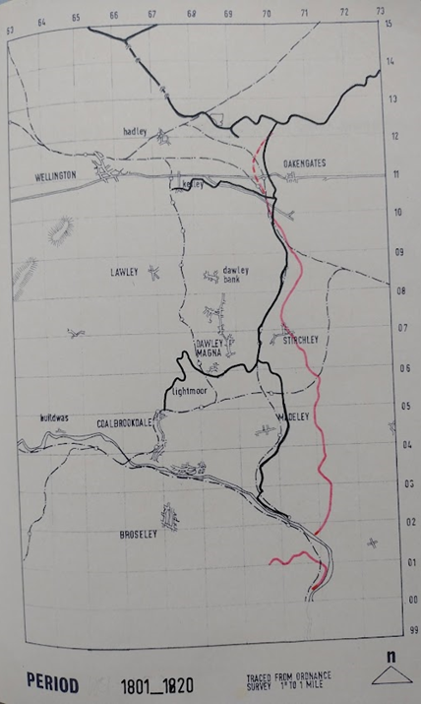
Savage & Smith in the 1960s (5) – 1801 – 1820 Iron Rails – 1” to 1 mile

Slide 35
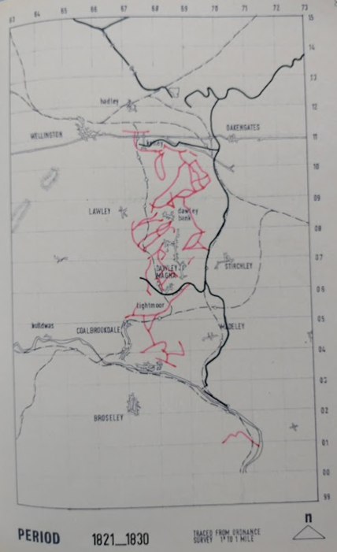
Savage & Smith in the 1960s (6) – 1821 – 1830 Iron Rails – 1” to 1 mile

Slide 36
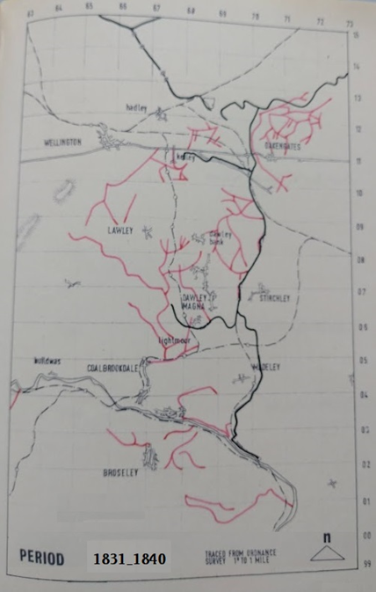
Savage & Smith in the 1960s (7) – 1831 – 1840 Iron Rails – 1” to 1 mile

Slide 37
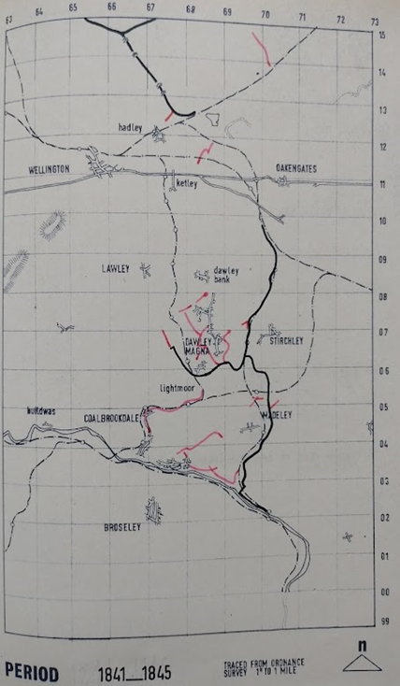
Savage & Smith in the 1960s (8) – 1841 – 1845 Iron Rails – 1” to 1 mile

Slide 38
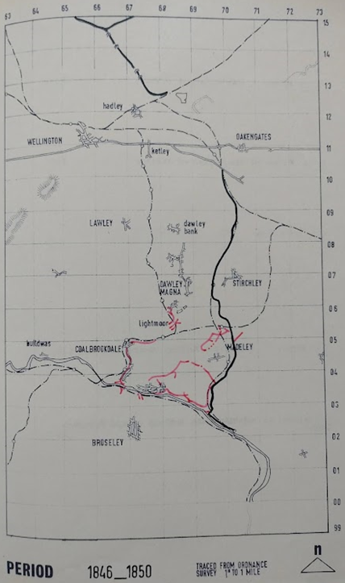
Savage & Smith in the 1960s (9) – 1846 – 1850 Iron Rails – 1” to 1 mile

Slide 39
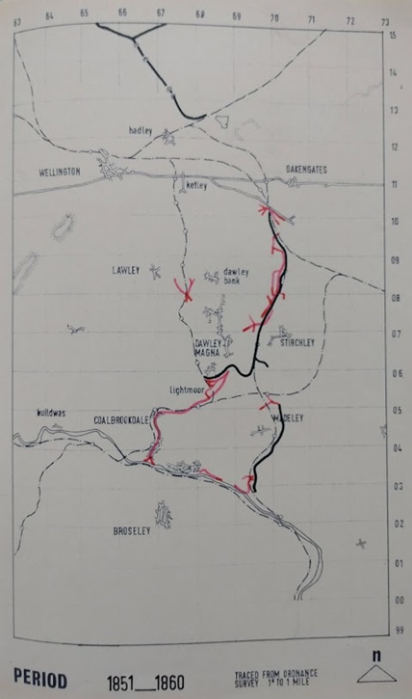
Savage & Smith in the 1960s (10) – 1851 – 1860 Iron Rails – 1” to 1 mile

Slide 40
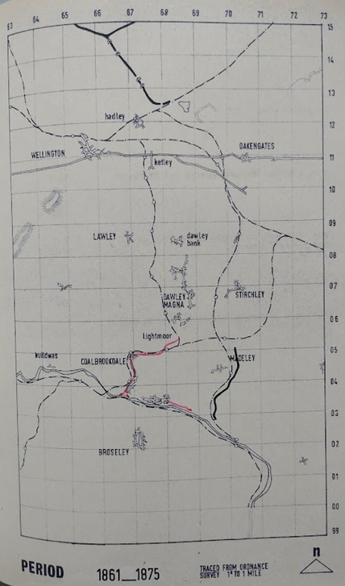
Savage & Smith in the 1960s (11) – 1861 – 1875 Iron Rails – 1” to 1 mile

Slide 41
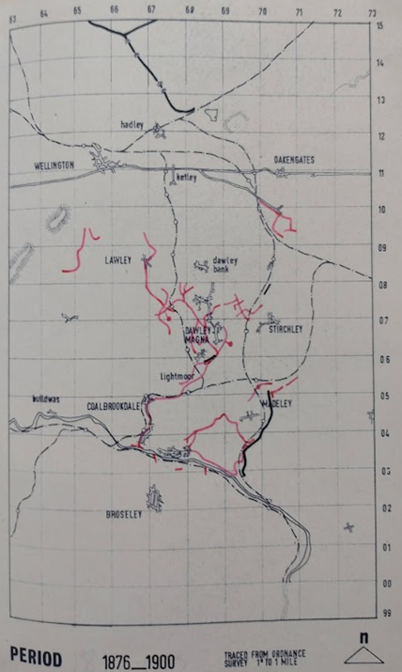
Savage & Smith in the 1960s (12) – 1876 – 1900 Iron Rails – 1” to 1 mile

Slide 42
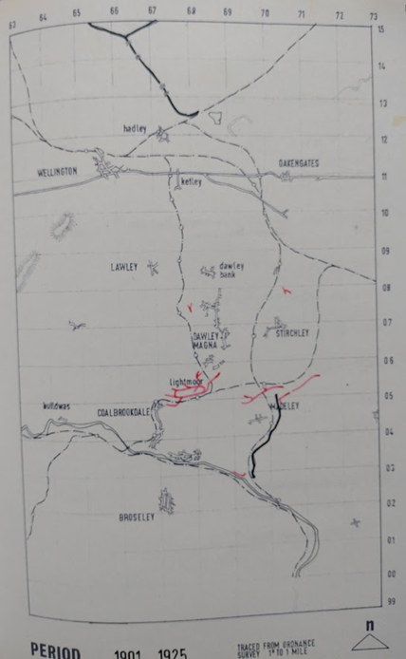
Savage & Smith in the 1960s (13) – 1901 – 1925 Iron Rails – 1” to 1 mile

Slide 43
Savage & Smith in the 1960s (13)
Savage & Smith’s research resulted in a series of hand-drawn maps at two different scales with different purposes:
1” to 1 mile: providing a chronology of change in the transport networks in East Shropshire – tramroad, canal and railway.
6” to 1 mile: showing routes on a geographical basis, but restricted to what, in Savage & Smith’s view, were the most salient details.

Slide 44
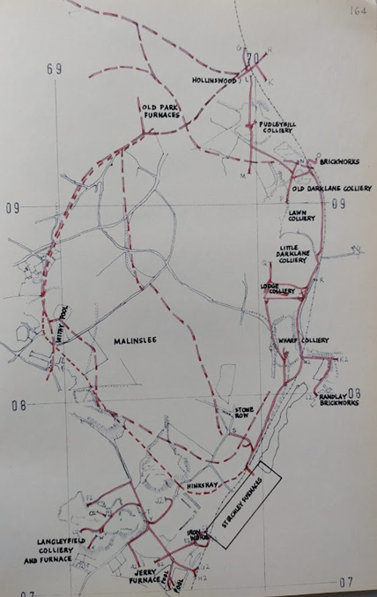
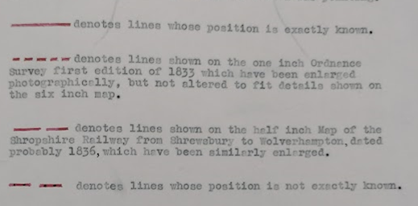
Savage & Smith (14) – Malinslee, Stirchley & Hollinswood - 6” to 1 mile
Savage & Smith’s key to their 6” to 1 mile drawings

Slide 45
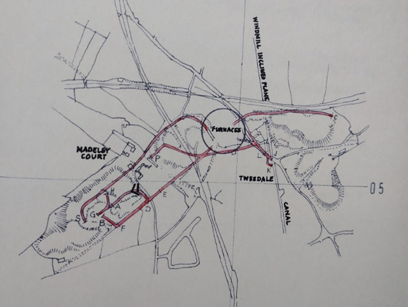
Savage & Smith (15) – Madeley Court
6” to 1 mile

Slide 46
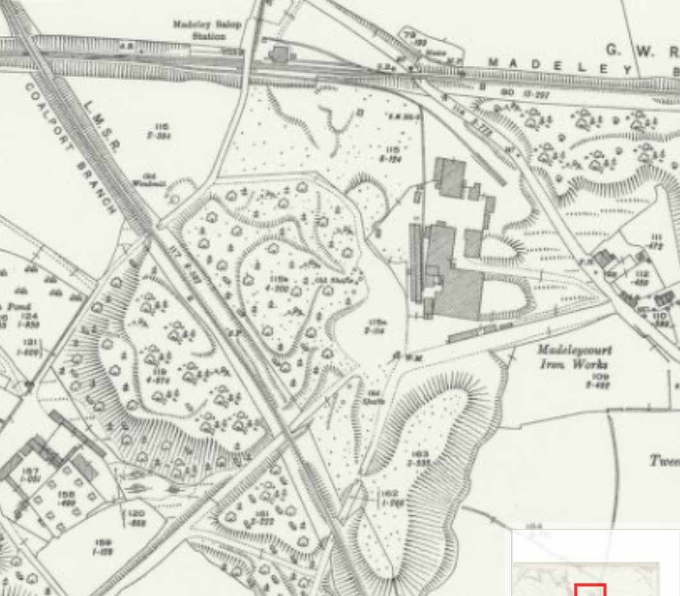
Madeley Court
25” to 1 mile
1927
By 1927, the Tramways had been replaced by a single spur from the East end of Madeley Salop Station

Slide 47
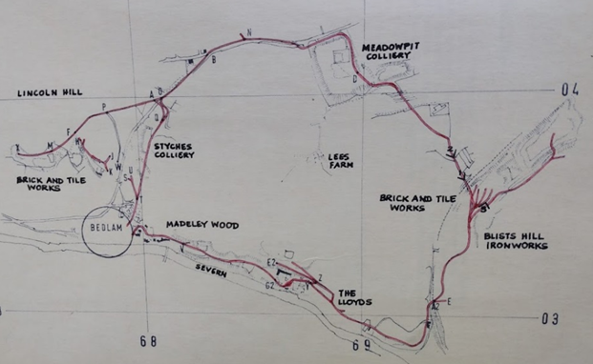
Savage & Smith (16) – Madeley Wood & Bedlam Furnaces
6” to 1 mile

Slide 48
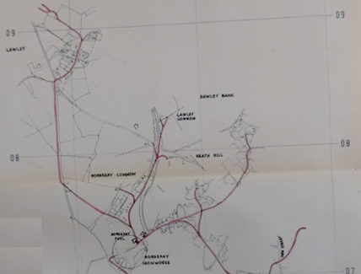
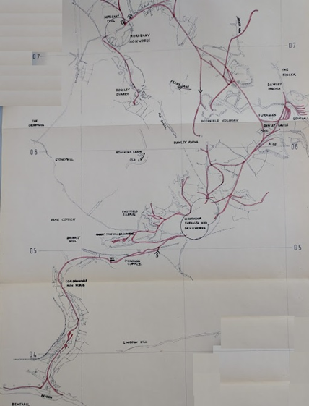
Savage & Smith (17) Coalbrookdale Tramways
6” to 1 mile
This network included Coalbrookdale, Lightmoor, Dawley, Horsehay, Lawley and Ketley.
Even excluding: Ketley which became separated from the Coalbrookdale network at an early stage; and the early wooden tramroad network. Savage and Smith needed a large fold out plan which shows up poorly here.

Slide 49
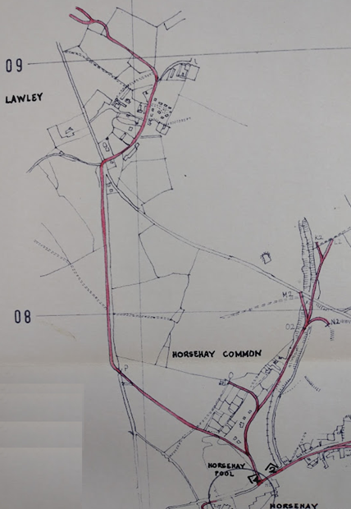
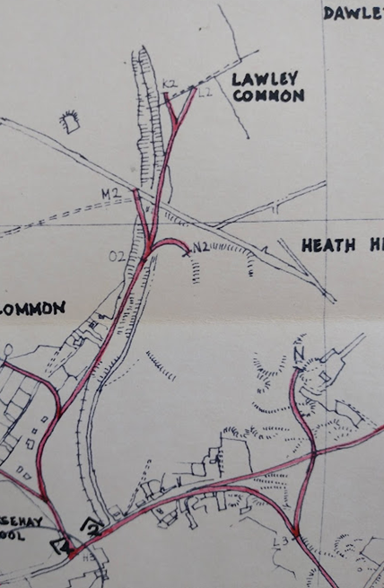
Savage & Smith (18)
Lawley
Horsehay

Slide 50
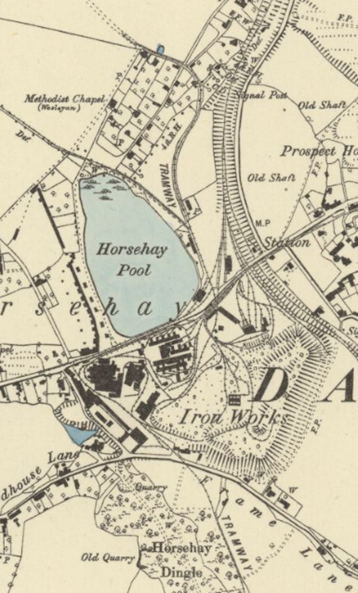
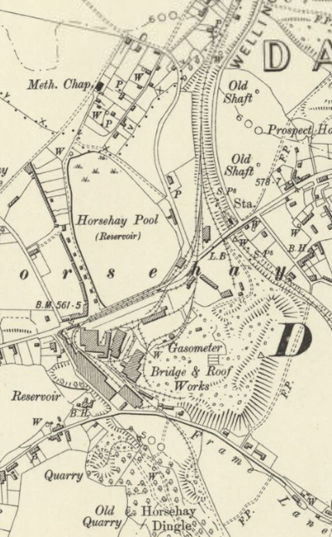
Changing Times at Horsehay (1)
1882
1901
Tramways were gradually replaced by standard-gauge railways

Slide 51
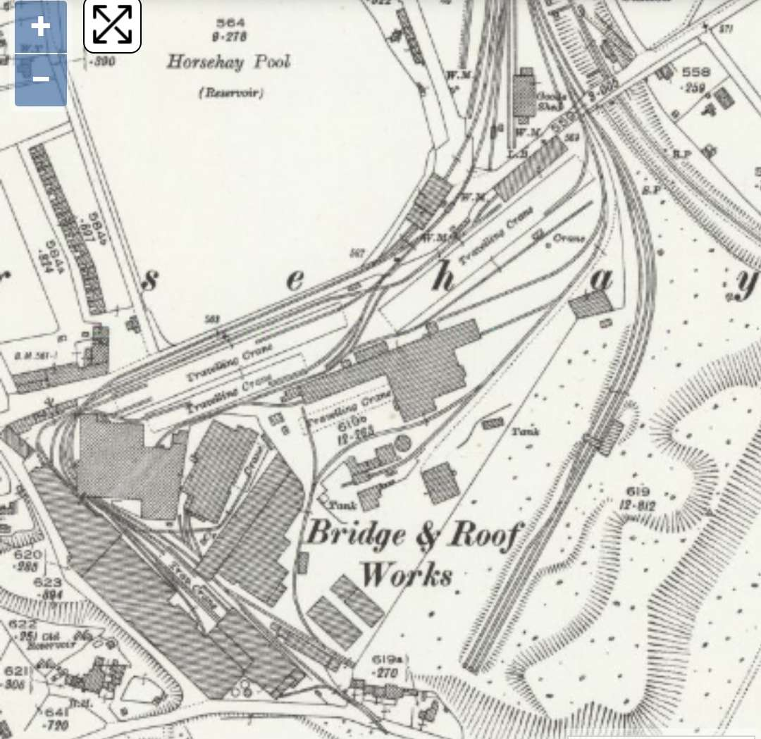
Changing Times at Horsehay (2)
1927
Tramways were gradually replaced by standard-gauge railways

Slide 52
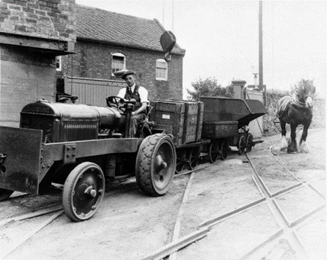
Changing times at Horsehay (3)
1882
1901
Horse-power was replaced by tractor-power in the early 20th century.
(Telford Memories Facebook Group – Lin Keska)

Slide 53
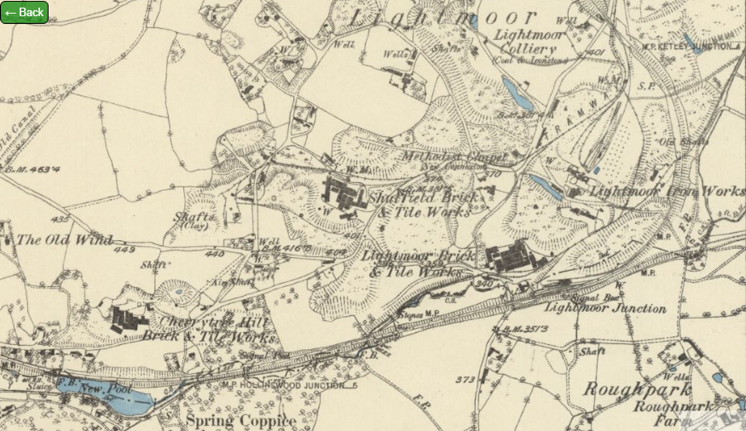
Lightmoor (1)
1882

Slide 54
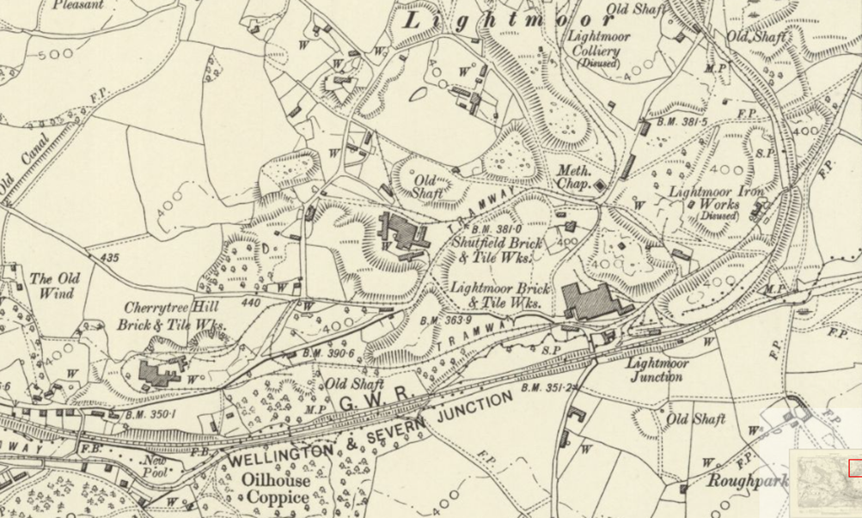
Lightmoor (2)
1901

Slide 55
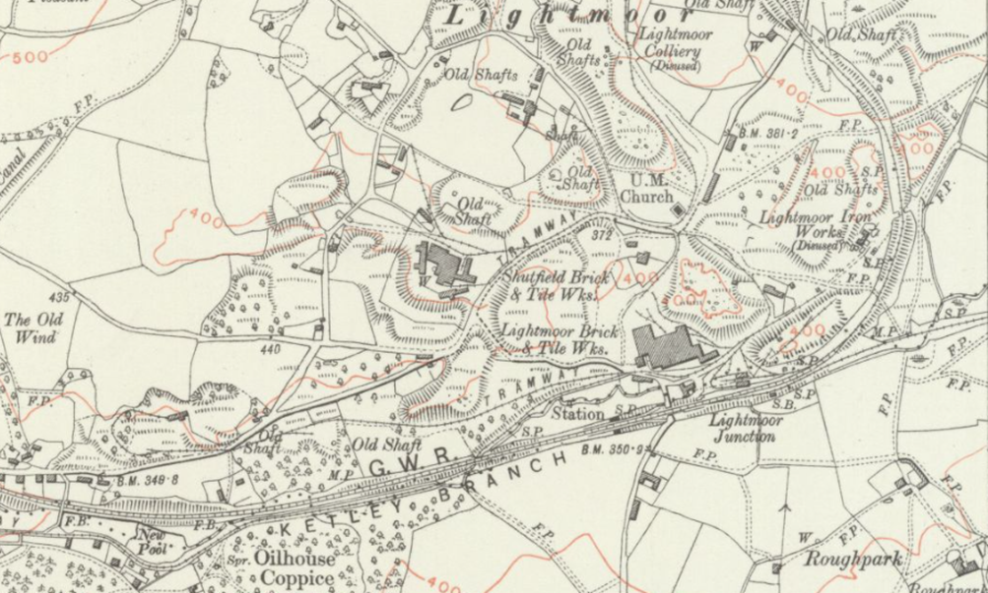
Lightmoor (3)
1925

Slide 56
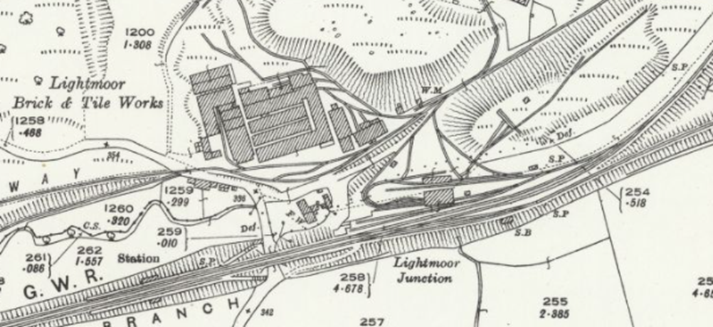
Lightmoor (4)
1925

Slide 57

Lightmoor (4)
Lightmoor Brickworks 1910, from the North.
Telford Memories Facebook Group (Paul Mower)

Slide 58

Lightmoor (5)
Lightmoor Brick Works approx. 1910, from the Southeast.
Telford Memories Facebook Group (Thomas Cooper)

Slide 59

Tramroads in East Shropshire
Notes for this talk can be found on the following
link on my blog (rogerfarnworth.com):
https://rogerfarnworth.com/2023/01/22/ancient-tramroads-near-telford-part-10-an-overview-of-the-east-shropshire-areas-tramroad-network/

Slide 60
Tramroads in East Shropshire
Resources:
Bertram Baxter; Stone Blocks and Iron Rails ; David & Charles, Newton Abbott, 1966.
Mark Jones; Discovering Britain’s First Railways ; The History Press, Cheltenham, 2012.
Derek Hayes; The First Railways ; The Times, HarperCollins, Glasgow, 2017.
Heather Hurley; Horse Drawn Tramways of the Wye Valley ; Logaston Press, Eardisley, 2022.
R.F. Savage & & L.D.W. Smith; The Waggon-ways and Plate-ways of East Shropshire ; Birmingham School of Architecture, 1965. (Ironbridge Museum Trust Archive)
The International Conferences on Early Railways

